Slide 1
Flexible Ethernet Traffic Restoration in Multi-layer
Multi-domain Networks
Bhuwan Pandey, Dominic Mohrhardt
Department of Computer Science & Engineering
Wright State University
Dayton, OH 45435

Slide 2
Outline
Problem
Terms to Learn
Paper contribution
Algorithm Objective
Constraints
Solution
Off-Line Learning Phase
Algorithm 1
On-Line Learning Phase
Algorithm 2
Compared Algorithms
Performance Evaluation
Conclusion

Slide 3
Problem
Given a Multi-Layer Multi-Domain network with a Flexible Ethernet implementation
  Reroute traffic from a lost physical link to spare capacity in another Flexible Ethernet Subgroup
  Use the flexible nature of Flexible Ethernet to maximize network utilization
  Make the process computationally efficient
  Minimize traffic disruption

Slide 4
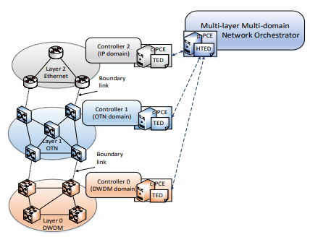
Terms to Learn
Multi-layer Multi-domain (MLMD)
  The actual layer, or way data is transmitted is mixed
    This means that Fiber, 5g, Ethernet, and RF are all parts of the network
  There are also multiple domains
    Domains are physical or virtual splits
      Enterprise network
      ISP network
      Cellular network

Slide 5
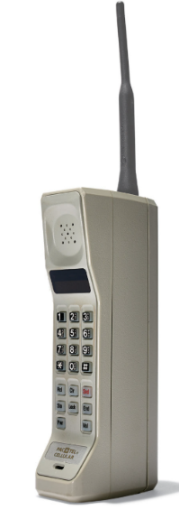

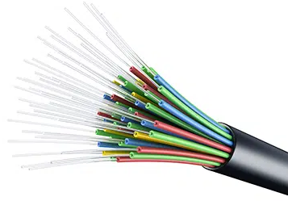
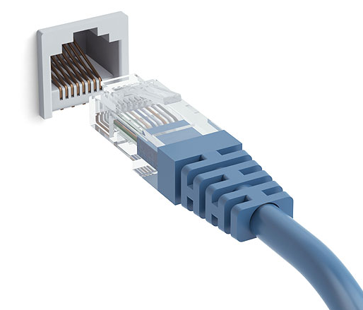
Terms to Learn
Physical Link (PHY)
  This is the physical connection that supports the layers we are talking about
    The fiber line and routers
    The ethernet connection
    The 5G Cellular connection

Slide 6
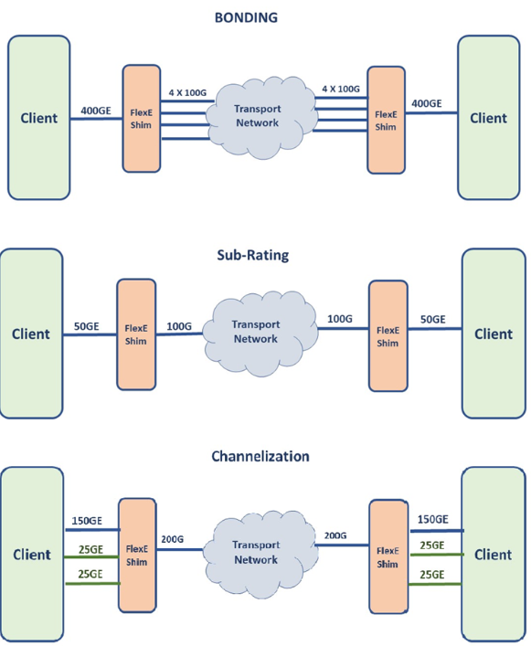
Terms to Learn
Flexible Ethernet (Flex E)
  Join or break available ethernet connection into smaller or bigger connections
  Split a 10 gigabit ethernet PHY into 10 1 gigabit ethernet PHYs
  Join 4 2.5 gigabit ethernet PHY into one 10 gigabit ethernet PHY

Slide 7
Paper Contributions
Change the way the FlexE Traffic restoration (FTR) is perceived by turning it into a Mixed Integer Nonlinear Program (MINLP)
Use learning theory and approximation to solve the FTR issue
Evaluate how this new algorithm performs by comparing to
  An older Routing and FlexE Assignment (RFA) Algorithm in the author’s previous paper
  Disjoint Shortest Path (DSP)

Slide 8
Algorithm Objective
Maximize the restoration throughput
Minimize the latency of our update and reconfiguration delays
Minimize the time and computation of using the new PHY for routing
  We do this by maximizing our spare capacity on our currently open PHYs

Slide 9
Constraints
Each reconfiguration of FlexE is at least the number of slots before failure
The total number of clients in FlexE doesn’t exceed its capacity
Each FlexE client is assigned to each flexE subgroup
We must consider a worst link load
  This happens when a FlexE subgroup hasn’t freed up their PHYs for transmission because new PHYs need to be setup or allocated
All traffic for a PHY must be routed along the same path or tunnel
The total number of PHYs allocated to a subgroup can not exceed the actual number of PHYs
When we recover slots for data among other FlexE subgroups we must recover them in ascending order

Slide 10
Solution
Study every FlexE group and subgroup and find the best weight and throughput over the entirety of time the link has been up and choose the one with maximum value to reroute to
  Weight here is
    Bandwidth Cost
      How many slots are already used
    Reliability Cost
      High loading or resource sharing for subgroup meaning it could become congested
    Performance Cost
      Latency, distance, jitter of the connection
The initial proposal was NP-hard
  Can’t solve it quickly since every link needs to be studied over time and computed
Authors propose solving this by breaking it into two problems
  Off-line learning the intra-domain delay and Maximum number of PHYs that can be provisioned during failure
  Heuristic for on-line traffic restoration
    Professional guessing

Slide 11
Off-line learning phase
The algorithm runs iteratively to approximate the optimal solution
Path Computation Element (PCE)
  Take data from domain elements meant to calculate these values
  Ask the Parent PCE what all the Child PCEs have calculated
Stochastically greedy
  Choose a random set at each moment and pick the one that has the best values for the situation

Slide 12
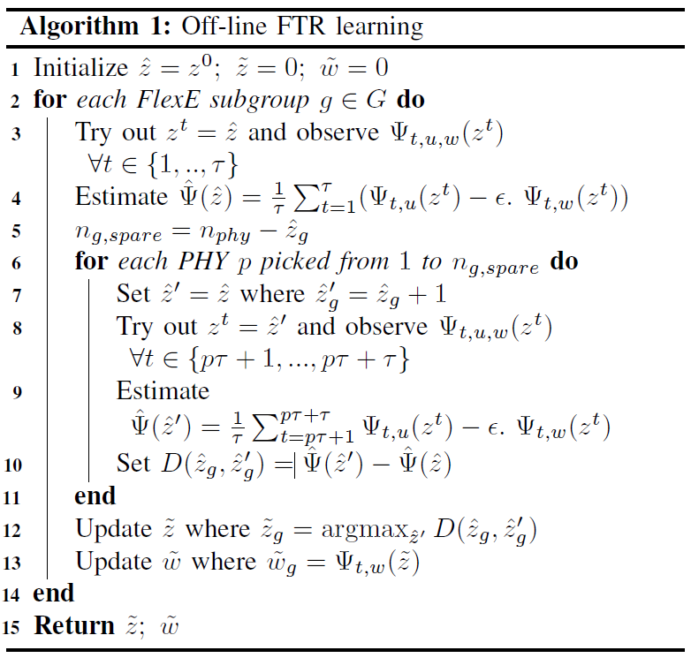
Algorithm 1
Computes the maximum number of spare PHYs and the weight of the FlexE subgroups

Slide 13
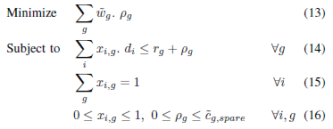
On-Line Learning Phase
On-Line Phase algorithm uses the previous data learned in the off-line learning phase and reroutes traffic
Additional Formula
  Wg is the weight
  Pg is the spare capacity
  Rg is residual capacity we gain after deallocating
  One client one subgroup
  One connection for each subgroup and client for domain constraint

Slide 14
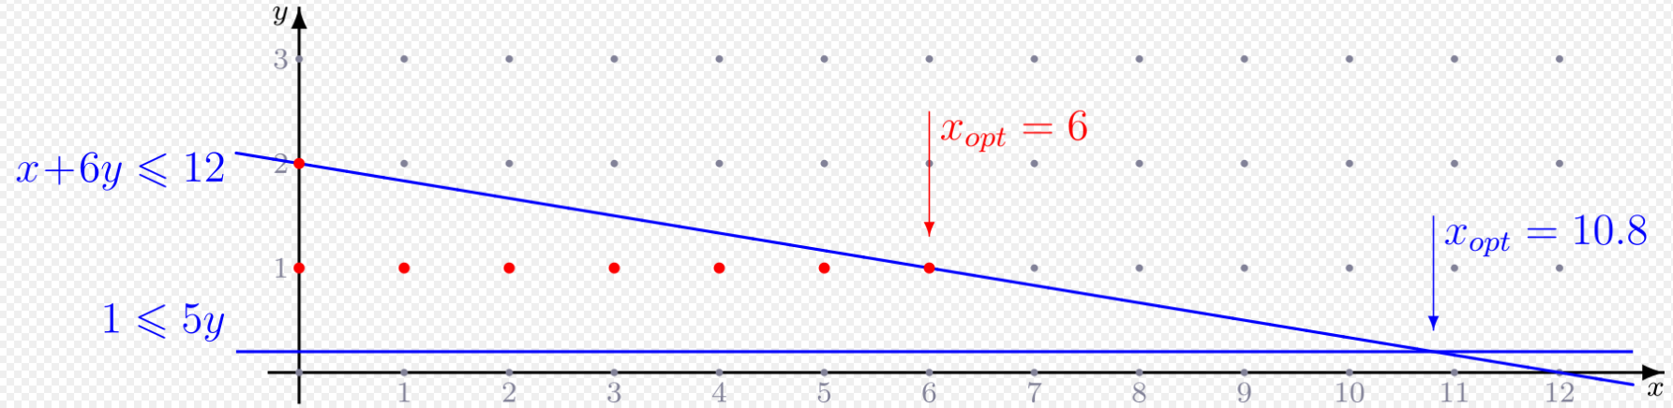
On-Line Learning Phase
Linear Programming Relaxation (LP-Relaxation)
  This is what makes this computationally simpler
  The problem is framed as a mixed integer linear program
  LP-Relaxation is designed to give a solution to these type of problems
  Use the dividing line and find the most optimized solution
  Don’t have to compute every possible iteration
    We can see the line and pick the optimal solution

Slide 15
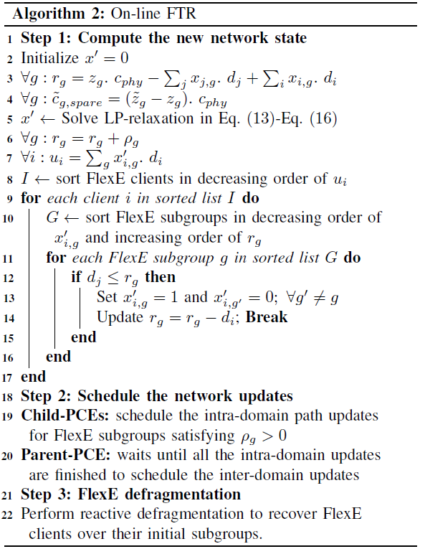
Algorithm 2
Uses the best options from algorithm 1 and restores service

Slide 16
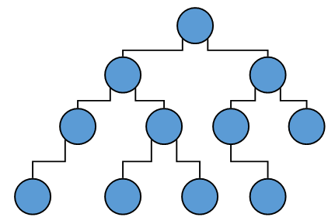
Compared Algorithms
Routing and FlexE Assignment RFA
  Build a tree of possible alternates and choose one based on capacity and latency
  The subgroups are organized once when a PHY failure occurs
  data is rerouted to go along the path of the tree
  In this case the higher calculated path is chosen
  All FlexE subgroups are rerouted

Slide 17
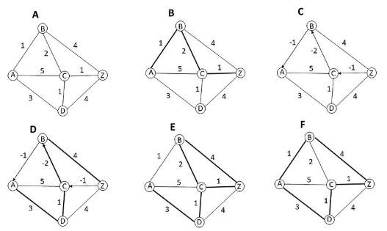
Compared Algorithms
Disjoint Shortest Path (DSP)
  When a PHY fails to calculate the shortest delay path
  Use this shortest delay path to reroute the packets from the broken PHY

Slide 18
Performance Evaluation
The authors use the MLMD testbed at TELUS-Ciena Lab in Edmonton, AB
This testbed includes the following
  4 Juniper routers connected through 40 and 100 Gigabit ethernet links
  4 Fujitsu optical switches
  3 Ciena 6500 DWDM platforms connected by 400G wave capacity links
  Each domain has a child-PCE
  The overall system has a parent-PCE

Slide 19
Performance Evaluation
The mean time to failure of the interdomain PHYs is set to 1 hour
The number of failures is set proportional to the hour number
  Hour 1: 1 Failure
  Hour 2: 2 Failures
  Hour 3: 3 Failures
  Etc.

Slide 20
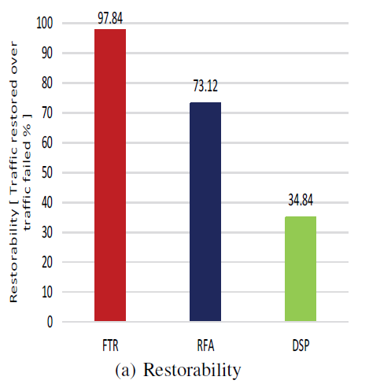
Performance Evaluation

Slide 21
Performance Evaluation
Restorability
  Ratio between recovered traffic and failed traffic
FlexE Traffic Restoration (FTR)
  This is the algorithm proposed in this paper
  97.84%
RFA
  Since all traffic needs to go through rerouting there is a specific advantage by using FTR
DSP
  This picks the first path and is less complex as compared to RFA and FTR giving up restorability

Slide 22
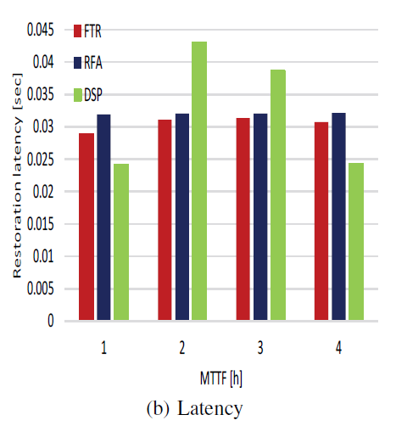
Performance Evaluation

Slide 23
Performance Evaluation
Latency
  The amount of time it takes to restore traffic over MTTF
FlexE Traffic Restoration (FTR)
  Smaller latency in most cases
  DSP is simpler and outperforms the algorithm here
RFA
  Slightly slower in latency but overall performs at the level of FTR
DSP
  Outperforms both in the 1 hour and 4 hour failure cases

Slide 24
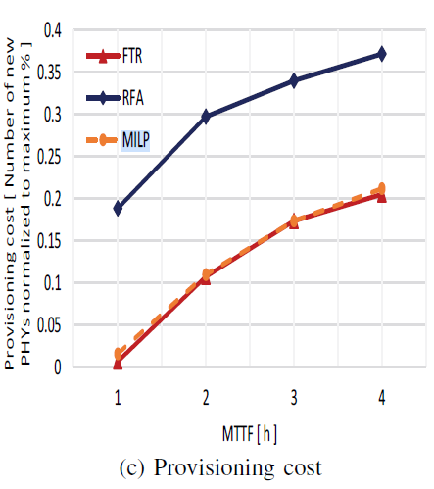
Performance Evaluation

Slide 25
Performance Evaluation
Provisioning Cost
  Ratio between the number of new PHYs and the maximum number of available PHYs over MTTF
FlexE Traffic Restoration (FTR)
  Follows closely with the “perfect” model of mixed integer linear programming problem (MILP)
RFA
  Close to twice the provisioning cost of FTR
MILP
  This the perfect solution if we were able to compute the values in the NP-Hard problem

Slide 26
Conclusion
The authors provided an effective solution to reroute traffic when a PHY between domains fails
Questions?

